Slide 1
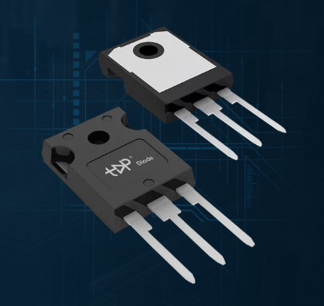
Basic Electronics (24B11EC111)
Lecture 1-3: MOSFET Introduction

Slide 2
Table of Contents
MOSFET-Introduction
MOSFET Structure
Device Operation- Zero Voltage
Device Operation- Channel Creation
Device Operation-with VDS

Slide 3
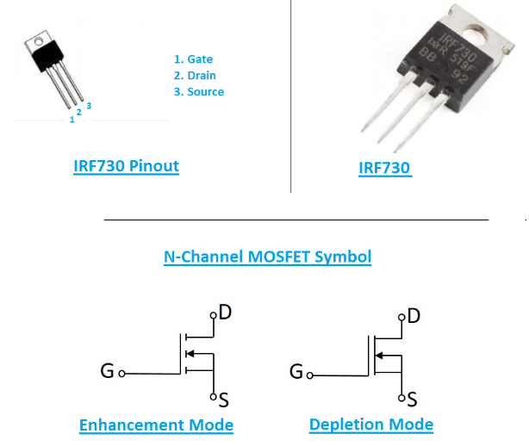
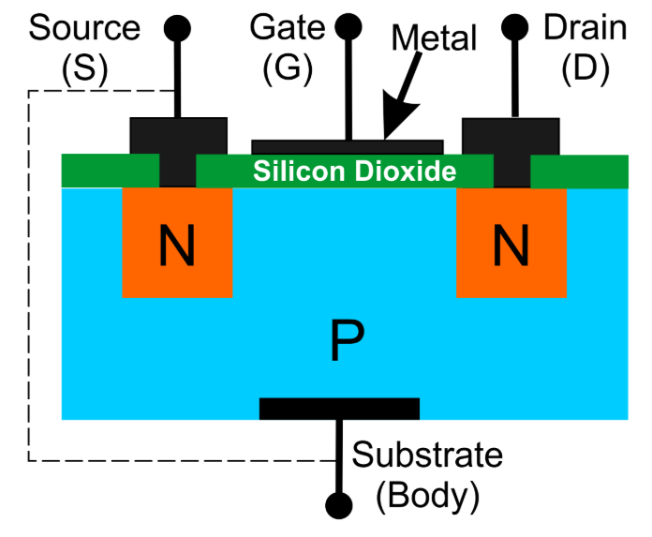
MOSFET
MOSFET- Metal Oxide Semiconductor Field Effect Transistor
MOSFET is an active device
It has three terminals- Gate, Drain, Source
It has four parts- Gate, Drain, Source and Body
It is a voltage controlled device (as BJT is a current controlled device)

Slide 4
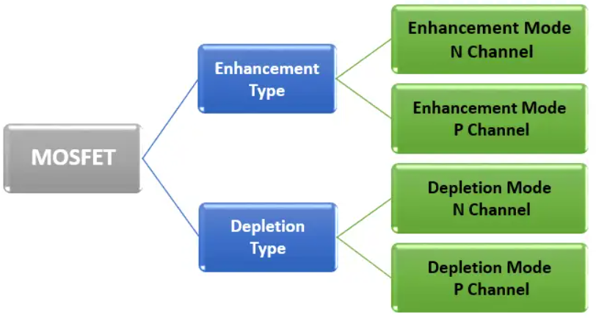
Types of MOSFET

Slide 5
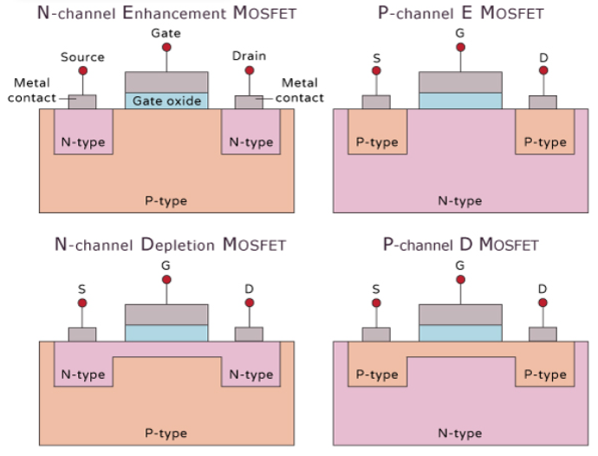
Types of MOSFET
Enhancement MOSFET
Act as normally OFF
On applying Vgs turns ON
Depletion MOSFET
Act as normally ON
On applying the Vgs turns OFF

Slide 6
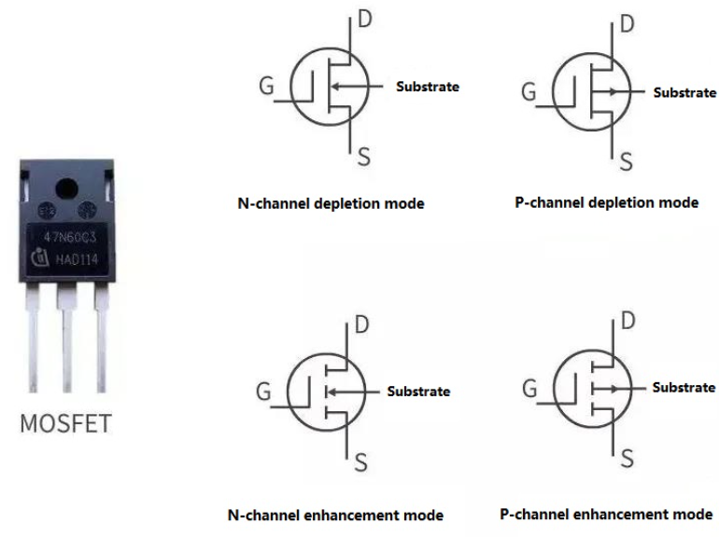
MOSFET Symbol

Slide 7
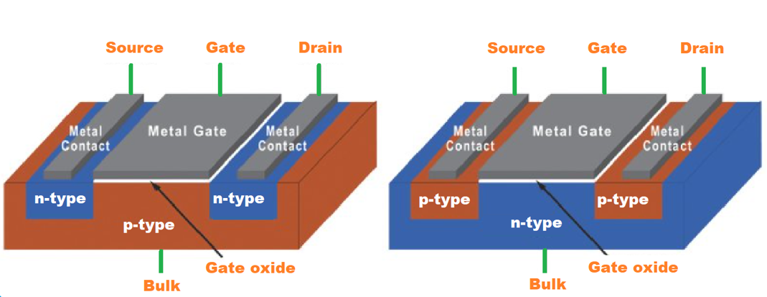
MOSFET
N-type Enhancement MOSFET
P-type Enhancement MOSFET
MOSFET is a unipolar device i.e. conduction of current is either carried out by the movement of electrons or holes
The conduction path between source and drain is normally called as channel
In MOSFET gate is practically separated from the entire body by insulating layer
The voltage at the gate terminal mostly controls the conductivity between drain and source (or width of channel)
Enhancement type MOSFET is the most widely used field-effect transistor

Slide 8
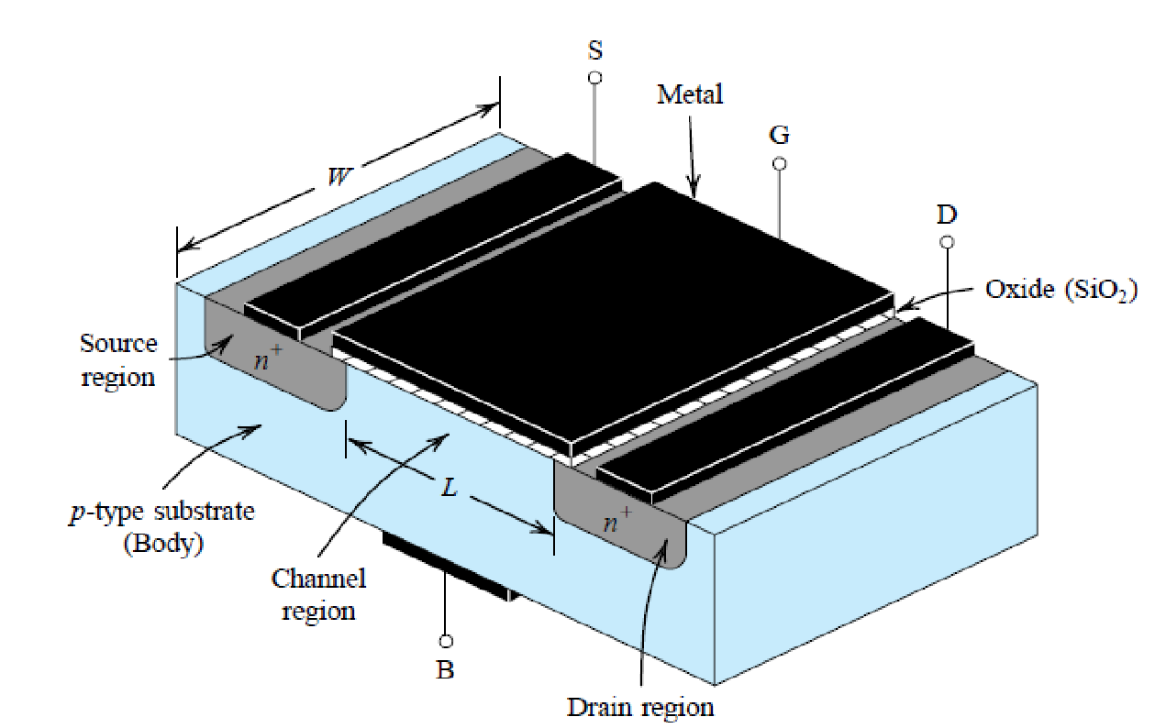
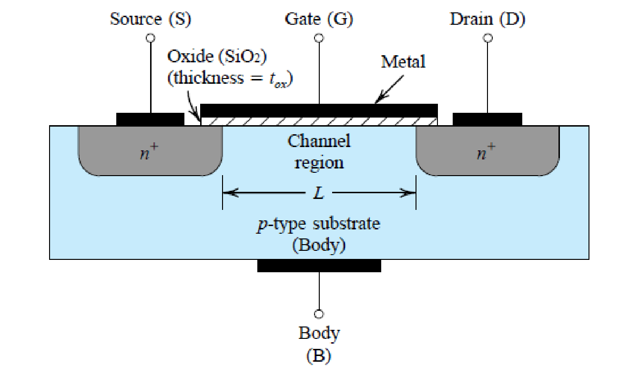
MOSFET Structure
The transistor is fabricated on a p-type substrate, which is a single crystalline silicon wafer that provides physical support for the device.
Two heavily doped region n+ source and n+ drain are created in the substrate
(a)
(b)
Fig1. N-channel MOSFET (a) Structure and (b) Side view

Slide 9
MOSFET Structure
Metal is deposited over the oxide region to form electrode of the device called gate
Metal is also deposited over the source, drain, and substrate region.
Another name of MOSFET is Insulated gate FET
Substrate forms PN Junction with source and Drain
MOSFET is symmetrical device with source and drain can be interchanged

Slide 10
MOSFET Structure
Voltage applied at gate terminal control the current flow between source and drain
Current will flow in longitudinal direction from drain to source as electron will flow from source to drain
Current will flow in the region called channel region with length L and width W

Slide 11
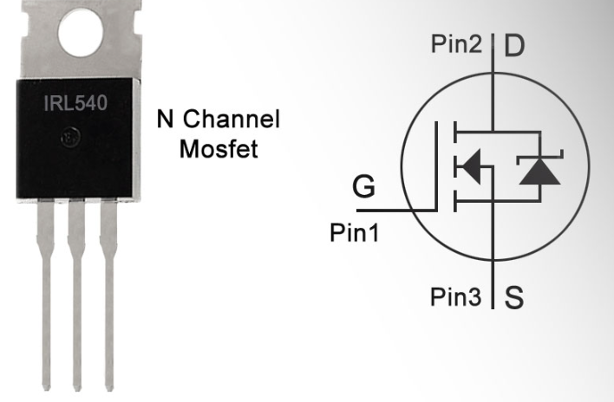
Device Operation
1. Zero Voltage Operation
For zero gate voltage two back to back diode exist between source to body and body to drain (i.e. drain and source)
One diode formed by – n+ drain region and the p-type
substrate
Second diode formed by - p-type substrate and n+ source region.
These back to back diodes will stop any flow of charge carriers from drain to source when Vds is applied.
1
3
2

Slide 12
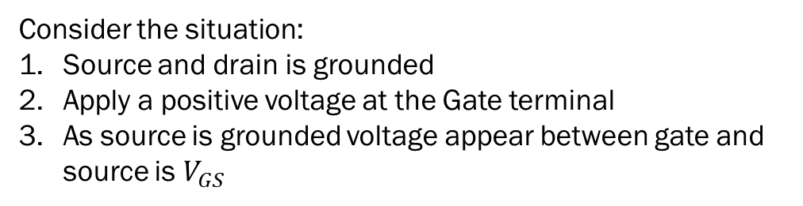
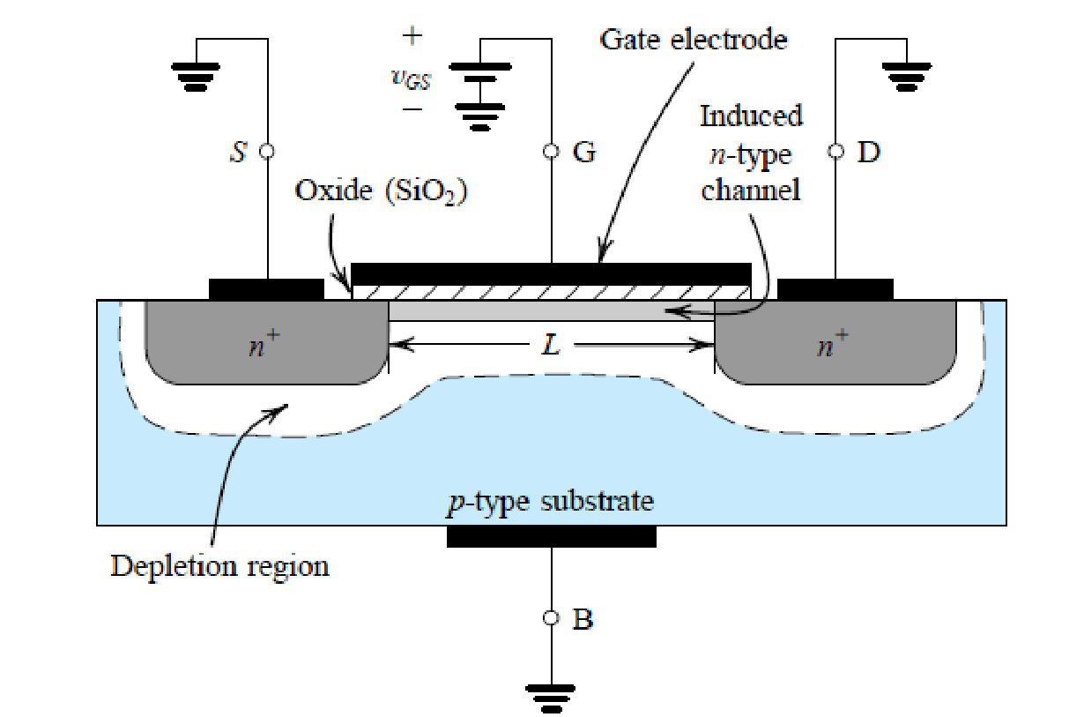
Device Operation
2. Creating Channel for Current Flow
Positive Vgs repels the positive charge present in the channel.
The holes are pushed back into the substrate leaving behind carrier depletion region.
The depletion region is populated with negative charges bounded to acceptor ions.
These charges are uncovered as the positive charges are pushed back in the substrate.

Slide 13
Device Operation
2. Creating Channel for Current Flow (contd….)
Positive Vgs attracts electrons from source and drain where these charges are in abundance.
When sufficient no. of electrons are accumulated a n-channel region is created below the gate and between the source, drain region.
Now, applying a potential between Drain and Source, current will start flowing between source to drain through induced n-region.
This induced n-region will act as a current transport channel between source and drain.
The MOSFET is called n-channel MOSFET or NMOS Transistor

Slide 14
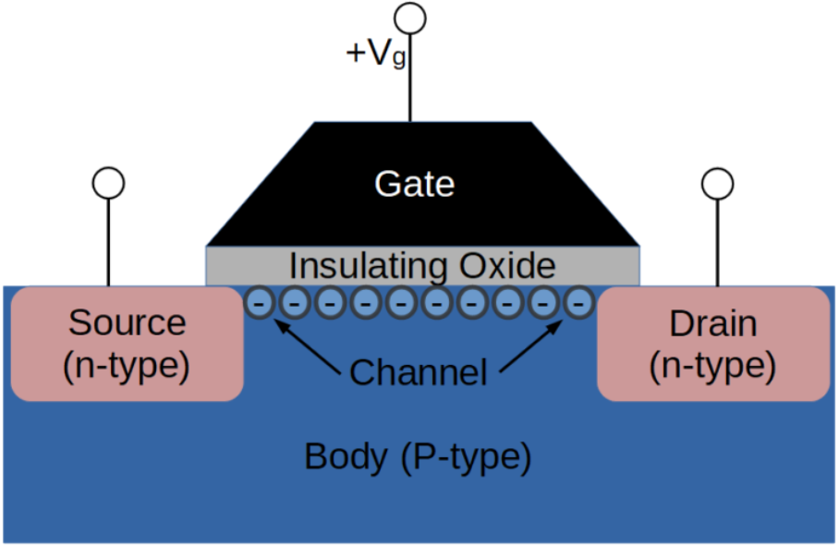
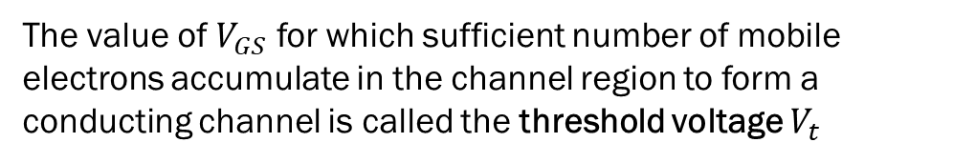
Device Operation
2. Creating Channel for Current Flow (contd….)
The NMOS transistor is fabricated over p-type substrate and the channel is created by inducing the n-type region into the p-type substrate.
So the induced channel is called inversion layer.

Slide 15
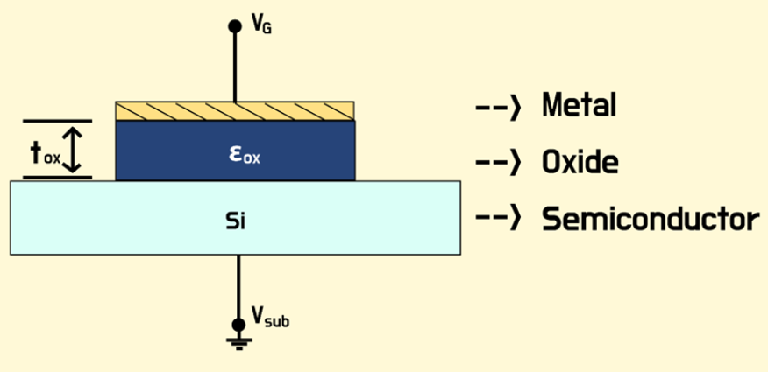
The field in channel region is in vertical direction as the gate separated by oxide act as a capacitor, positive charges accumulated at the top of the channel and corresponding negative charge at the bottom of the plate.`
An electric field thus develops in the vertical direction.
This electric field controls the amount of charge in the channel, and thus it determines the channel conductivity and, in turn, the current that will flow through the channel when a voltage Vds is applied.

Slide 16
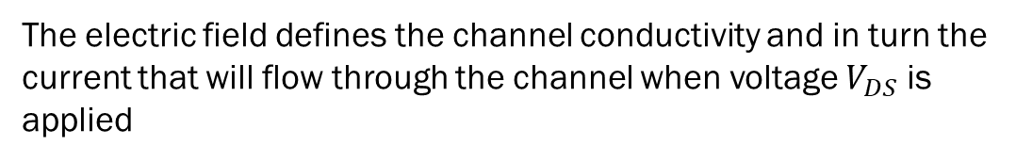
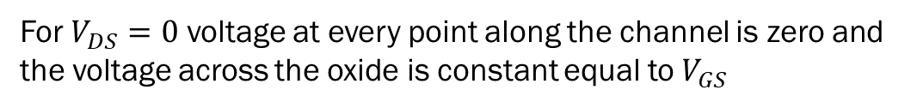
Device Operation
2. Creating Channel for Current Flow (contd….)
This gives the name Field Effect Transistor

Slide 17

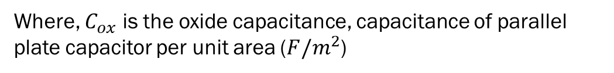
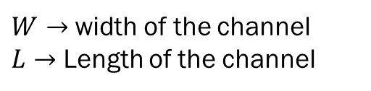

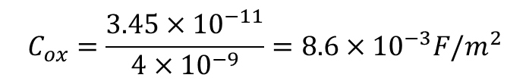


Device Operation
2. Creating Channel for Current Flow (contd….)
Now, we can express magnitude of the electron charge in the channel as---------------------
(1)
Oxide capacitance is given as--------------------
(2)
e.g. Oxide capacitance for these values is -------------------
and
*fF is femtofarad

Slide 18
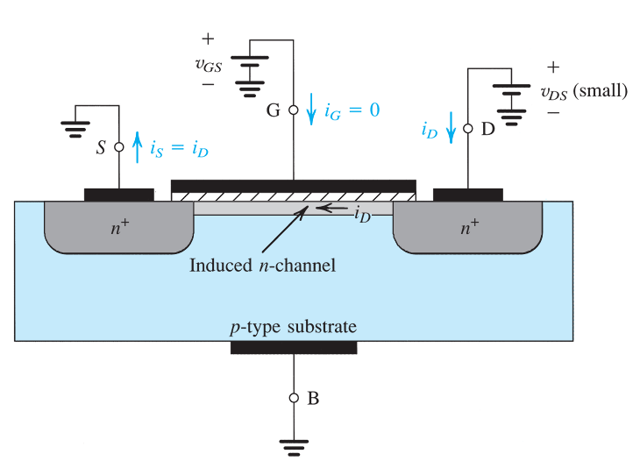
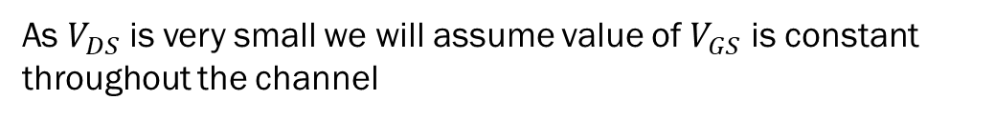

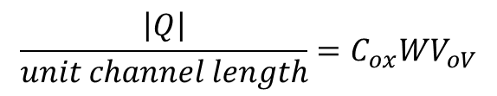
Device Operation
3. Applying Small VDS
Now ID starts flowing from drain to source through n-channel formed
Now, we already know
then

Slide 19
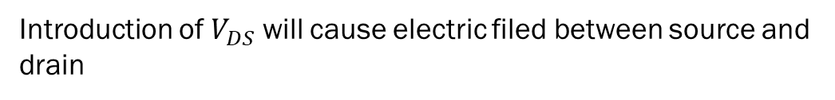

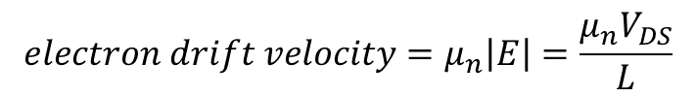
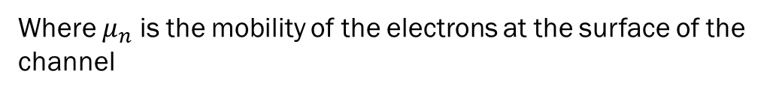
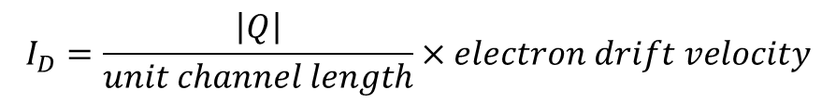
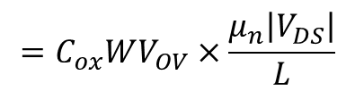
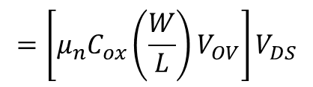
Device Operation
3. Applying Small VDS (contd…)
(3)
Now, the electric field will drift channel electrons towards the drain region with the velocity
(4)
Now, current in the channel can be calculated using
(5)
(6)
(7)

Slide 20
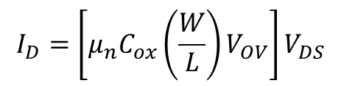
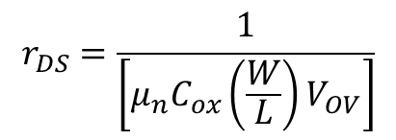
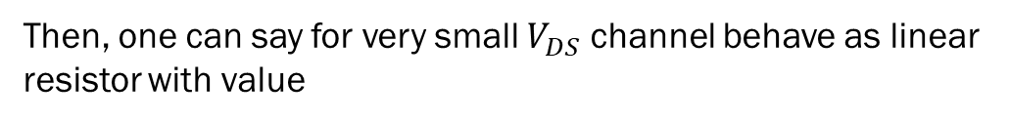


Device Operation
(8)
Now, conductance of the channel can be determined using
(9)

Slide 21


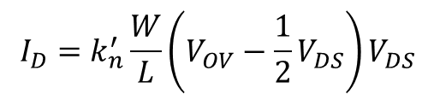
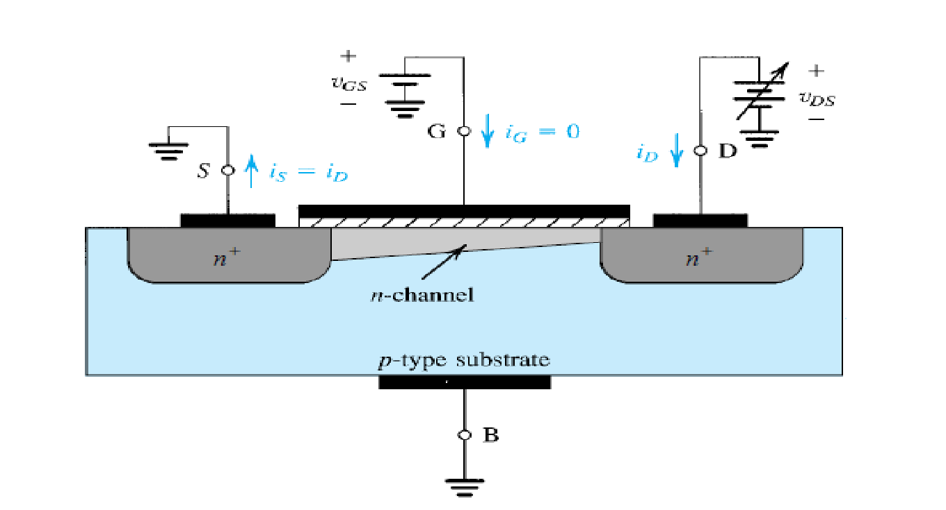
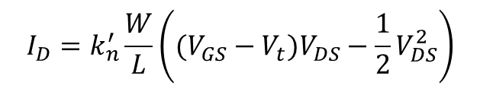
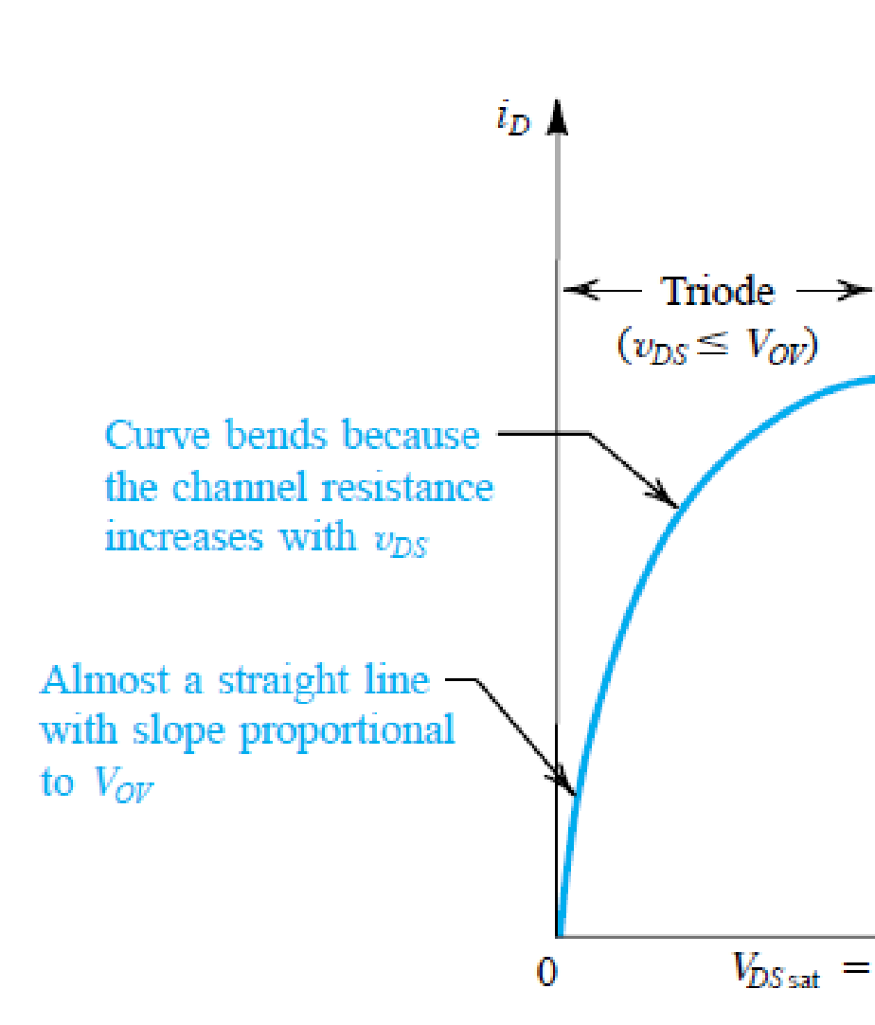


Slide 22
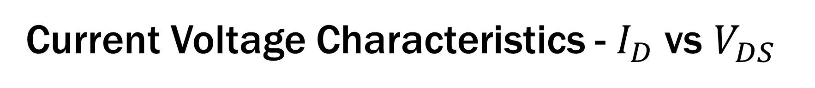

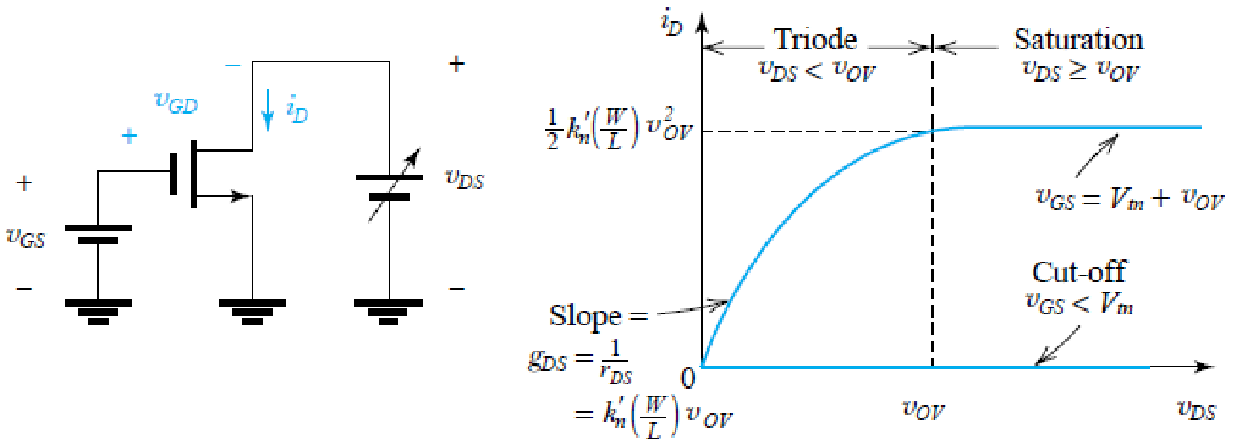
NMOS work as switch when operated in triode and cut-off region
NMOS is used in saturation region for application in amplification

Slide 23
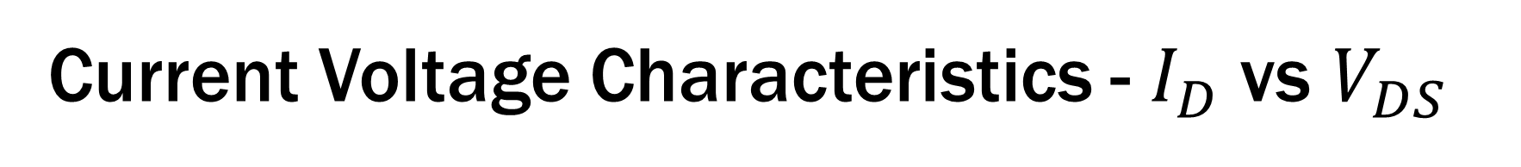

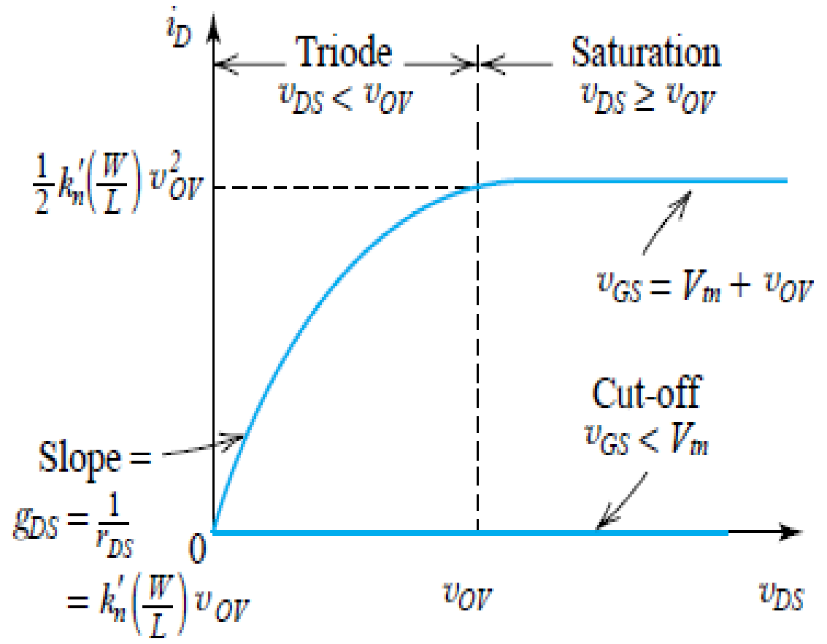

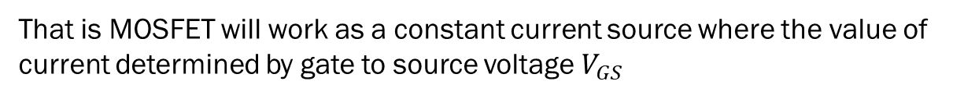
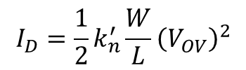
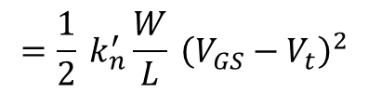
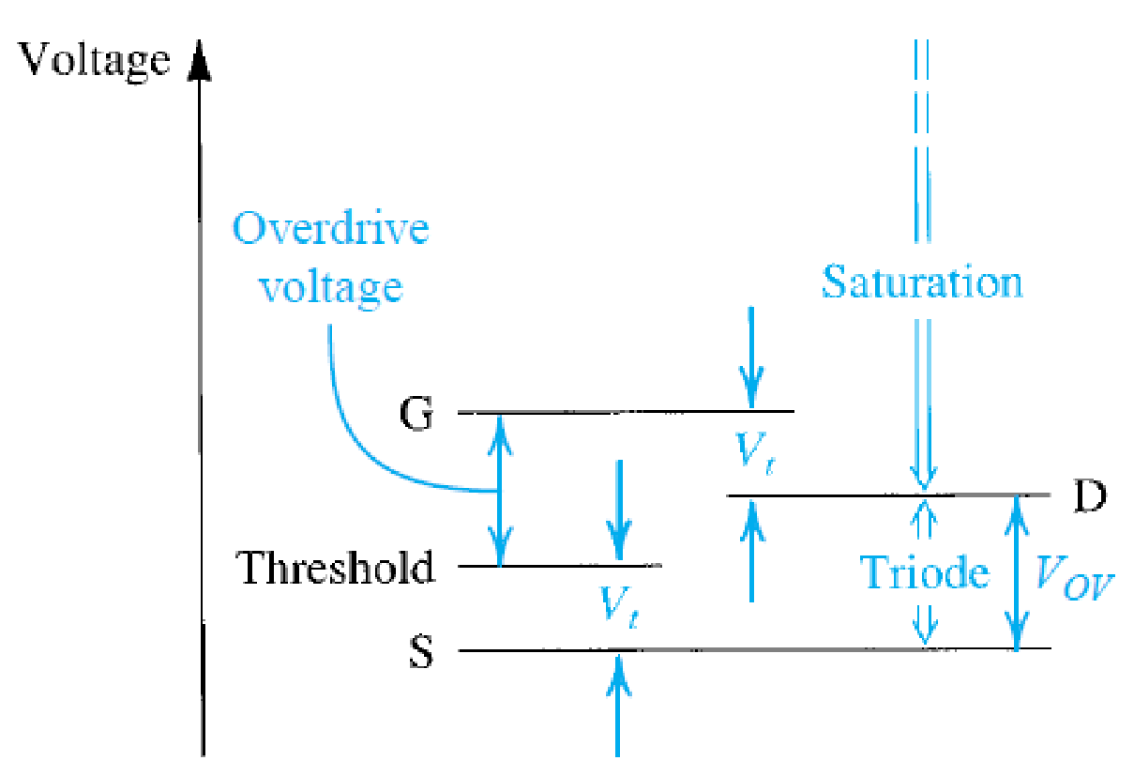
Non-linear behaviour
And this equation provide non-linear amplification

Slide 24
Reference
1. Sedra, Smith, Microelectronics Circuits, Sixth Edition, Oxford.

